Slide 1

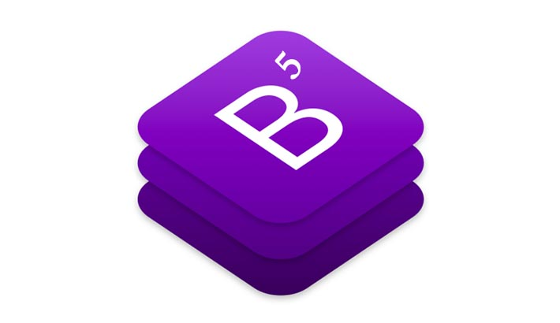

Slide 2
Bootstrap
Most Popular Frontend framework
For building responsive sites
Bootstrap, originally named Twitter Blueprint, was developed by Mark Otto and Jacob Thornton at Twitter as a framework to encourage consistency across internal tools.

Slide 3
Bootstrap
Installation
CDN
Download and attach

Slide 4
Bootstrap
Bootstrap = (Grid System + Classes + Components)

Slide 5
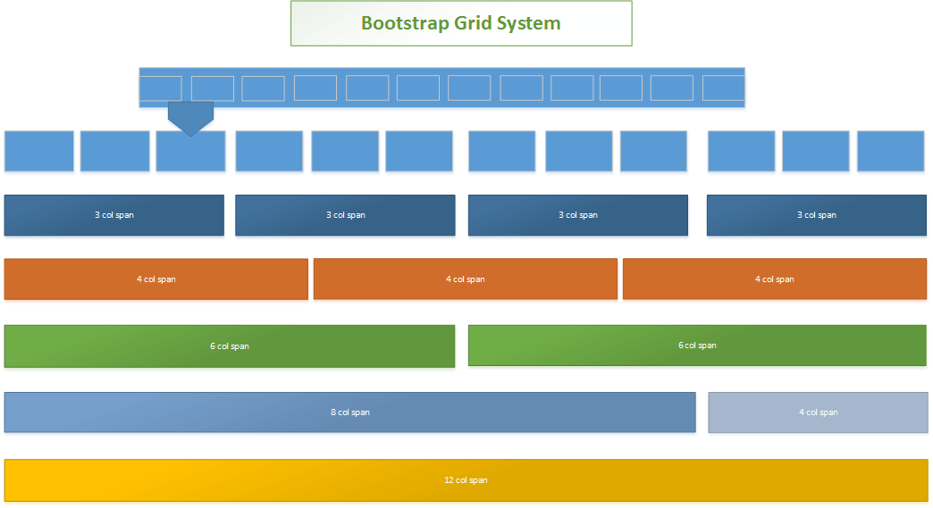
Bootstrap
Grid System (For Responsiveness)

Slide 6
Bootstrap
Grid System (For Responsiveness)
Breakpoints
Containers
Row
Column

Slide 7
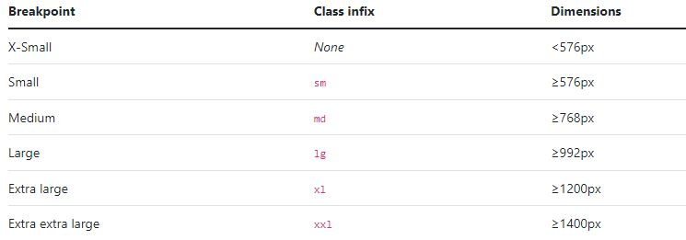
Bootstrap
Grid System (For Responsiveness)
1. Breakpoints

Slide 8
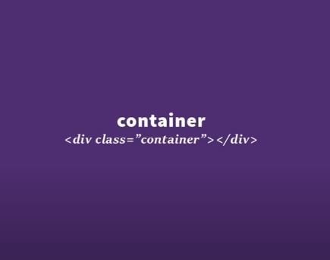
Bootstrap
Grid System (For Responsiveness)
2. Containers
Wrapper that contain the website
Website width depends on wrapper width
Ex: https://passwordsgenerator.net

Slide 9
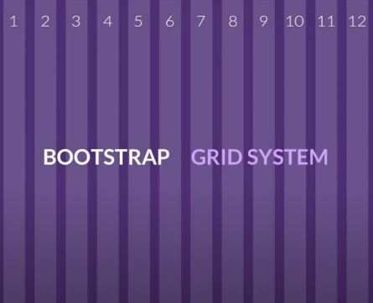
Bootstrap
Grid System (For Responsiveness)
3. Row
<div class="container">
<div class="row”> </div>
</div>
It is divided into 12 columns

Slide 10
Bootstrap
Grid System (For Responsiveness)
4. column(grid)

Slide 11
Bootstrap
Classes
Example: img-fluid class for making image Responsive
<img src=“....” class=“img-fluid” alt=“...”>

Slide 12
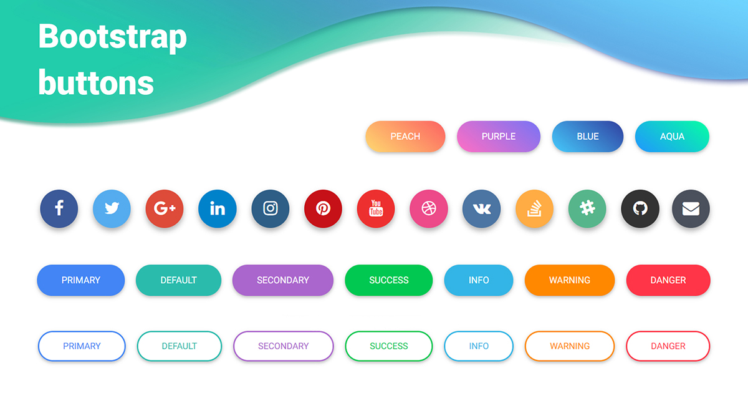
Bootstrap
Components
Components(Button)

Slide 13
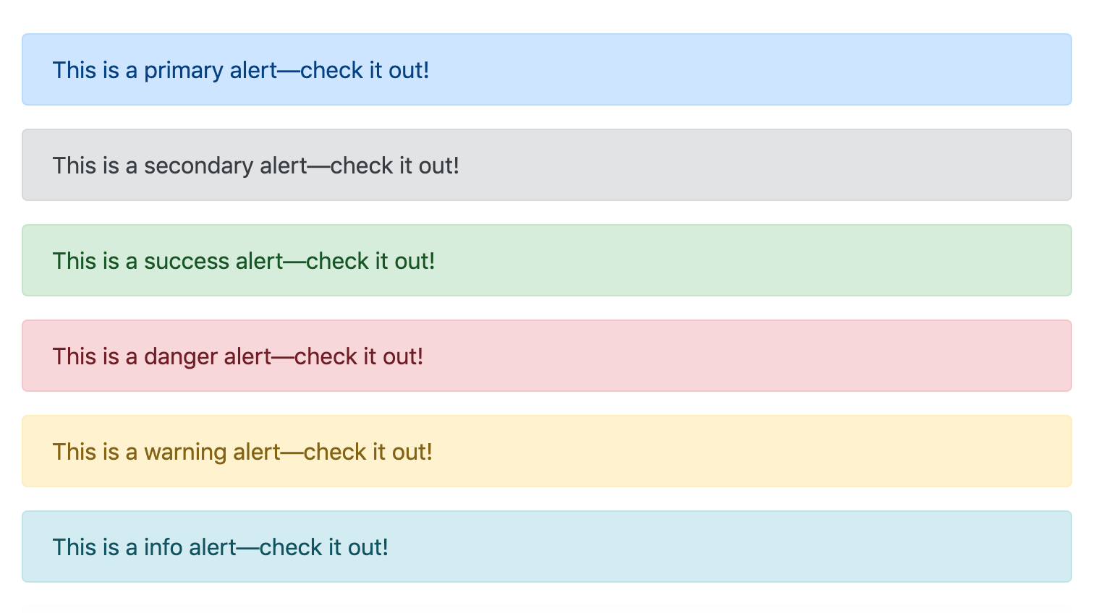
Bootstrap
Components(Alert)

Slide 14
Bootstrap
Reference
1. https://getbootstrap.com/
2. https://www.w3schools.com/bootstrap5/

